Slide 1

What is DevOps?

Slide 2

DevOps is the union of people, process, and products to enable continuous delivery of value to our end users.
The contraction of “Dev” and “Ops” refers to replacing siloed Development and Operations to create multidisciplinary teams that now work together with shared and efficient practices and tools.
What is DevOps?
Culture
Automation
Lean
Measurement
Sharing

Slide 3
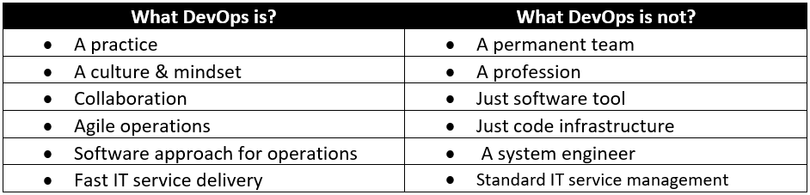
What is DevOps & What is not DevOps?

Slide 4

“Imagine a world where product owners, Development, QA, IT Operations and InfoSec work together, not only to help each other, but also to ensure that the overall organization succeeds.
By working towards a common goal, they enable the fast flow of planned work into production, while achieving world-class stability, reliability, availability and security.”
What is DevOps
Notes:
Key concepts:
This is a definition of DevOps from the introduction on the DevOps handbook
Note the different stakeholders listed
Think about all these people sharing a common goal
Note the concept of fast flow
Think about what ‘planned work’ means
Has it always been possible to balance stability, reliability, availability and security in the IT industry? How well are you doing that today?
“Imagine a world where product owners, Development, QA, IT Operations and InfoSec work together, not only to help each other, but also to ensure that the overall organization succeeds. By working towards a common goal, they enable the fast flow of planned work into production, while achieving world-class stability, reliability, availability and security.”
“Imagine a world where product owners, Development, QA, IT Operations and InfoSec work together, not only to help each other, but also to ensure that the overall organization succeeds. By working towards a common goal, they enable the fast flow of planned work into production, while achieving world-class stability, reliability, availability and security.”
“Imagine a world where product owners, Development, QA, IT Operations and InfoSec work together, not only to help each other, but also to ensure that the overall organization succeeds. By working towards a common goal, they enable the fast flow of planned work into production, while achieving world-class stability, reliability, availability and security.”

Slide 5

Why DevOps matter?
Notes:
Software and the Internet have transformed the world and its industries, from shopping to entertainment to banking. Software no longer merely supports a business; rather it becomes an integral component of every part of a business. Companies interact with their customers through software delivered as online services or applications and on all sorts of devices. They also use software to increase operational efficiencies by transforming every part of the value chain, such as logistics, communications, and operations. In a similar way that physical goods companies transformed how they design, build, and deliver products using industrial automation throughout the 20th century, companies in today’s world must transform how they build and deliver software.

Slide 6
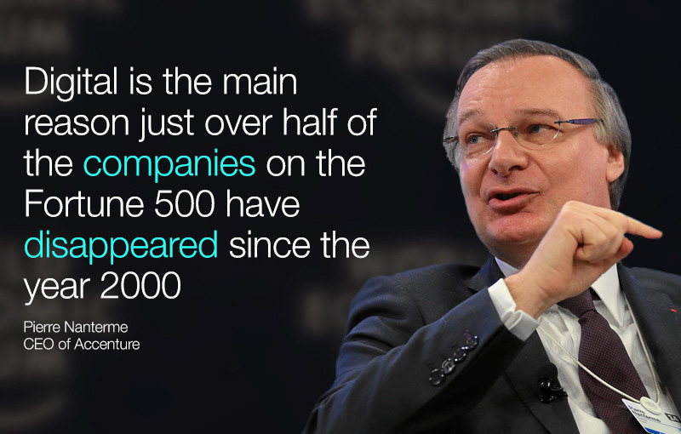
DevOps accelerates Digital Transformation
Quote from former CEO of Accenture at World Economic Forum

Slide 7
All Companies are now sharing their DevOps Stories
Web Pioneers
Amazon
Netflix
Etsy
Facebook
Salesforce
Google
Financial Services
Capital One
Bank of America
Barclays
Wells Fargo
ING Bank
UBS
American Express
Entertainment & Media
Disney
Sony Pictures
Hearst
Verizon
Insurance
Nationwide
Travelers
Kaiser Permanente
Hiscox
Manufacturing
Apple
LEGO
Unilever
Jaguar Land Rover
Adidas
Nike
Retail
Target
Nordstrom
Sherwin Williams
Macy’s
Walmart
Starbucks

Slide 8
Business Benefits of DevOps
Higher-quality
More reliable
Faster pace
Resulting in Accelerated time to market
Improved experience for customers
Increased revenue
Enhanced collaboration and communication,
Faster development and delivery processes
While delivering features, fixes and updates.
Bridges the communications gap between developer teams and IT operations
Quickly deliver solutions that best match the needs of both the customer and the business.

Slide 9
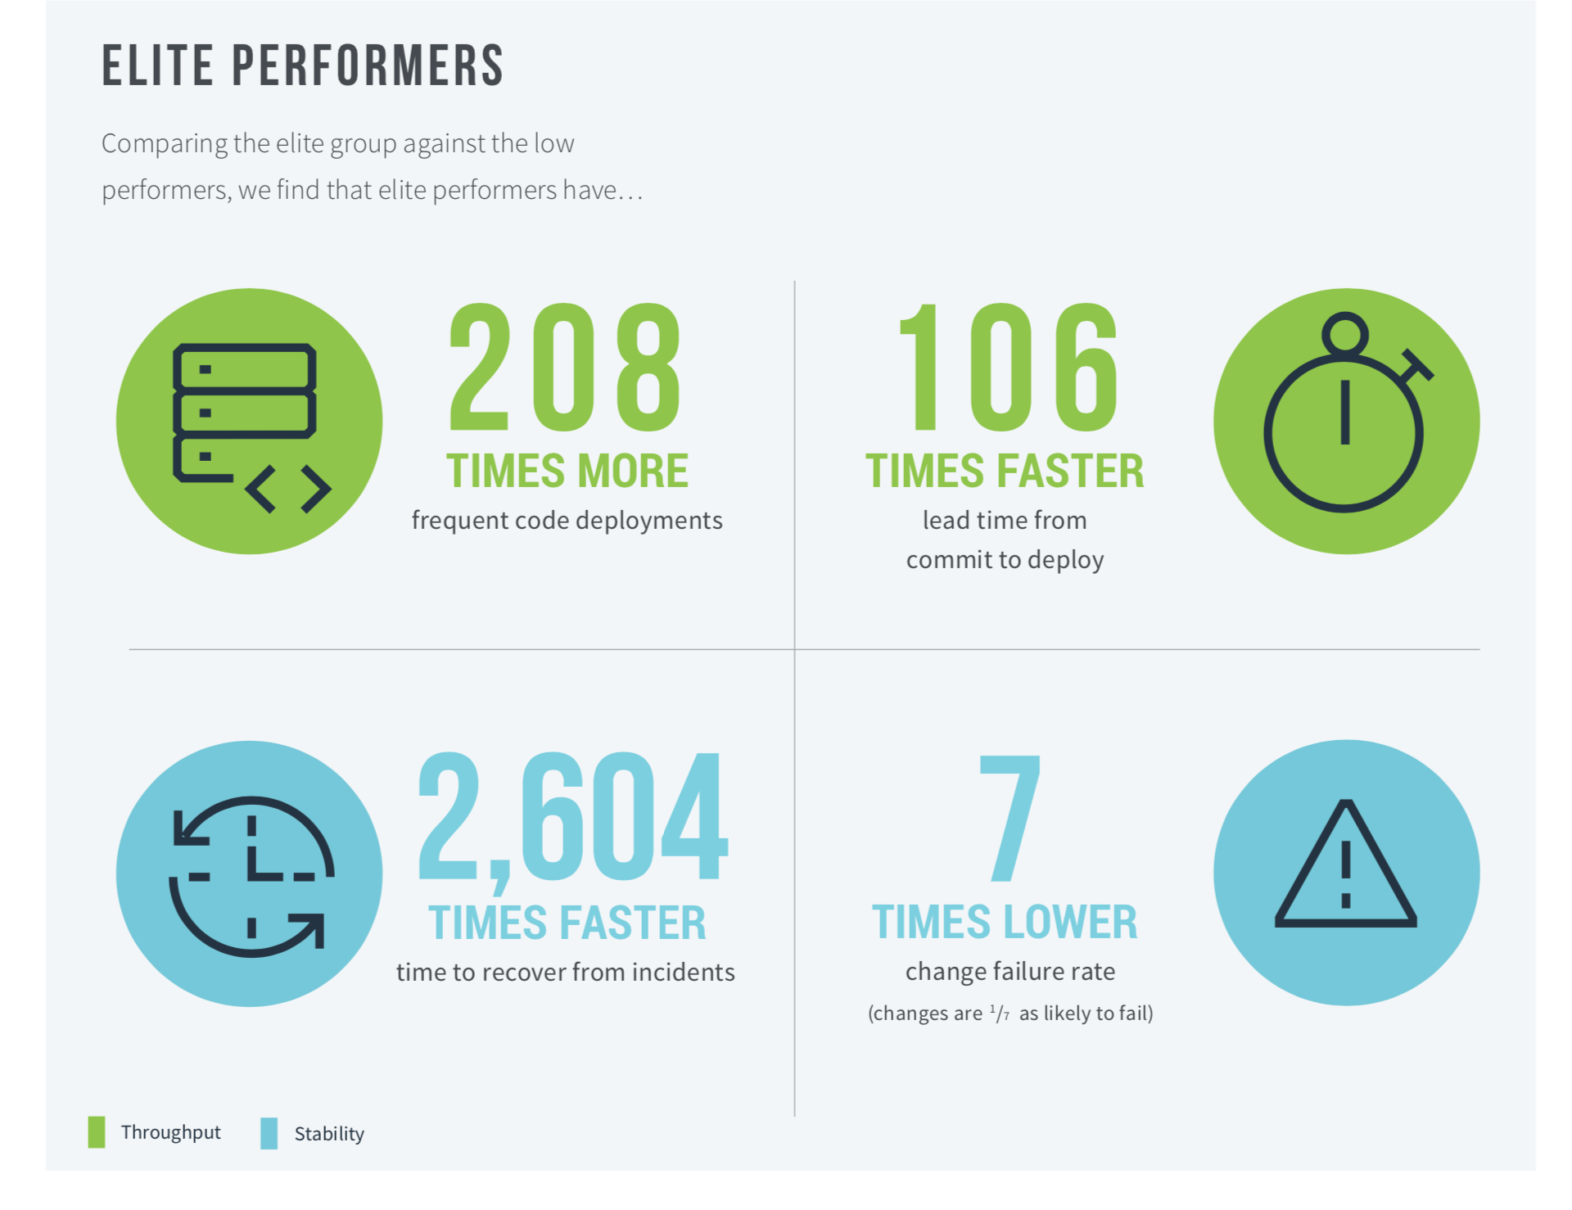
Business Benefits of DevOps

Slide 10
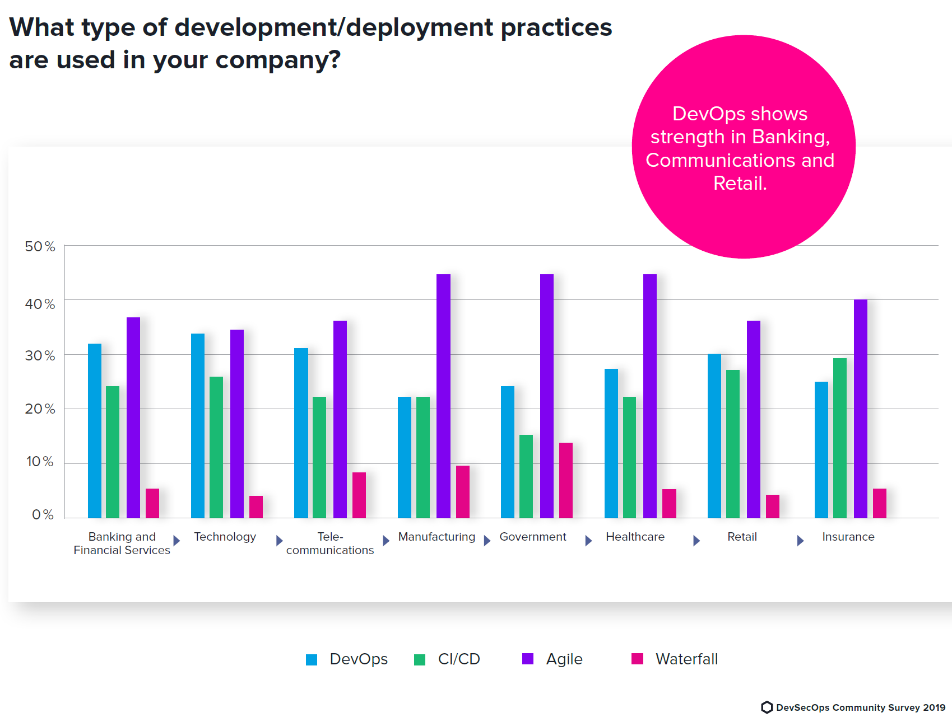
DevOps Adoption Across Sectors

Slide 11





Key Challenges for Organizations
Decentralized IT communities
Need to upskill
Individuals
Organizations facing talent gap
Need to improve software delivery
Need to align to enterprise goals
You can help by gaining DevOps skills to overcome some of these challenges

